Slide 1
NIEC CODING-GROUND

Slide 2
OBJECTIVE
The idea behind the project is to develop a web application which will allow teachers to upload assignments with respect to the sections and allowing students to run, compile and submit their work there itself.

Slide 3
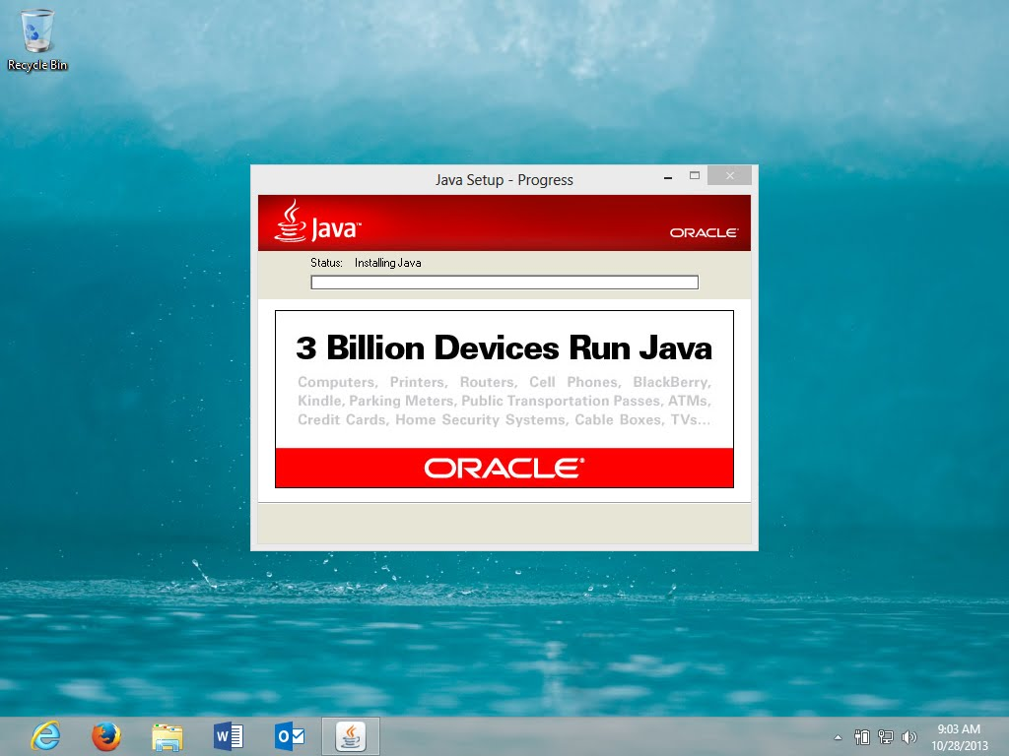
Existing system
In Existing System , Compilation is an Offline Process.
A sufficient amount of memory is utilized in the host machine as the Java Development Kit need to be installed in the host machine.

Slide 4
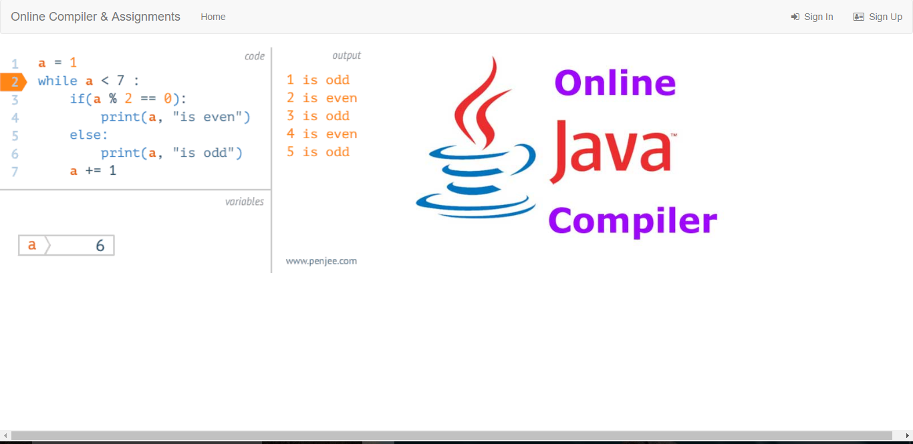
PROPOSED SYSTEM
We can compile and run our java program online.
No need to install JDK in our own system.
The client machine need only to be connected to the server.

Slide 5
MODULES
ADMIN
TEACHER SIGN-IN/SIGN-UP
STUDENT SIGN-IN / SIGN-UP
CODING GROUND

Slide 6
HOMEPAGE

Slide 7
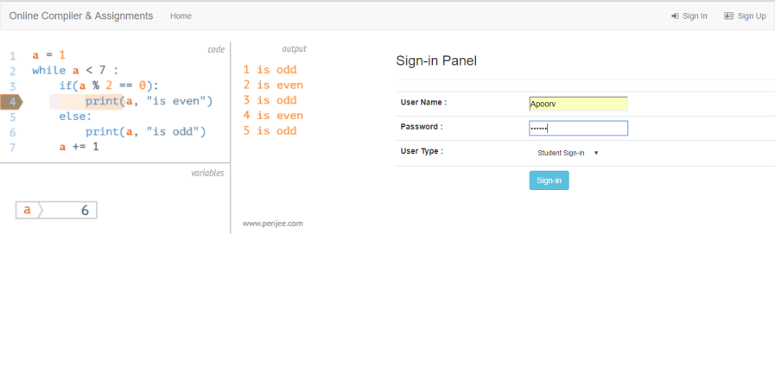
STUDENT panel Sign in/ Sign Up to use the application

Slide 8
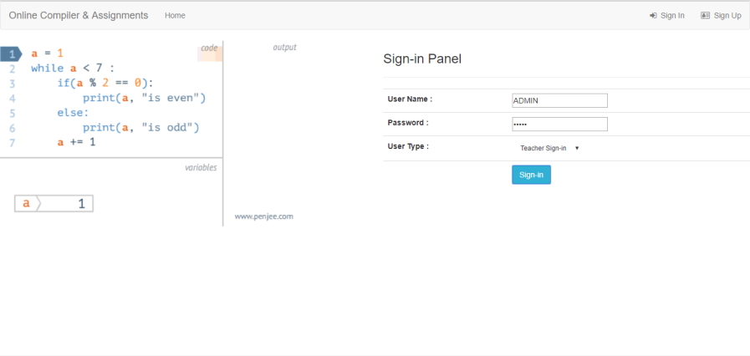
TEACHER/ADMIN panel TEACHER’S LOGIN

Slide 9
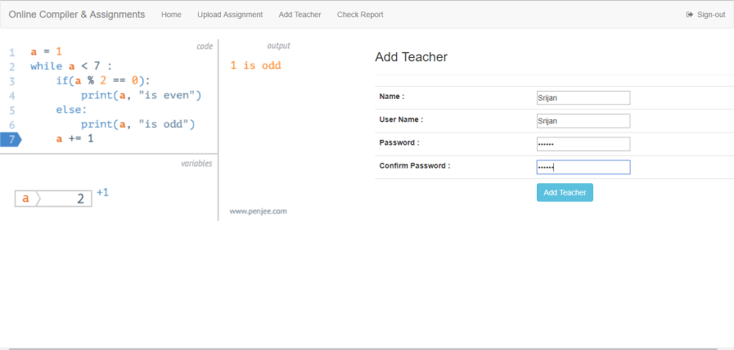
ADDING TEACHER EXISTING TEACHERS CAN ADD NEW TEACHERS

Slide 10
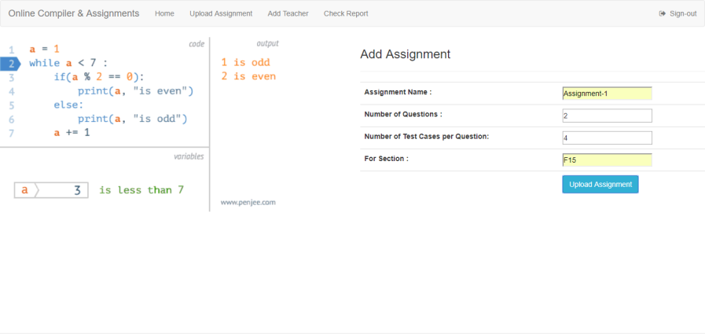
ADDING ASSIGNMENTS BY TEACHERS UNIQUE ASSIGNMENT NAME

Slide 11
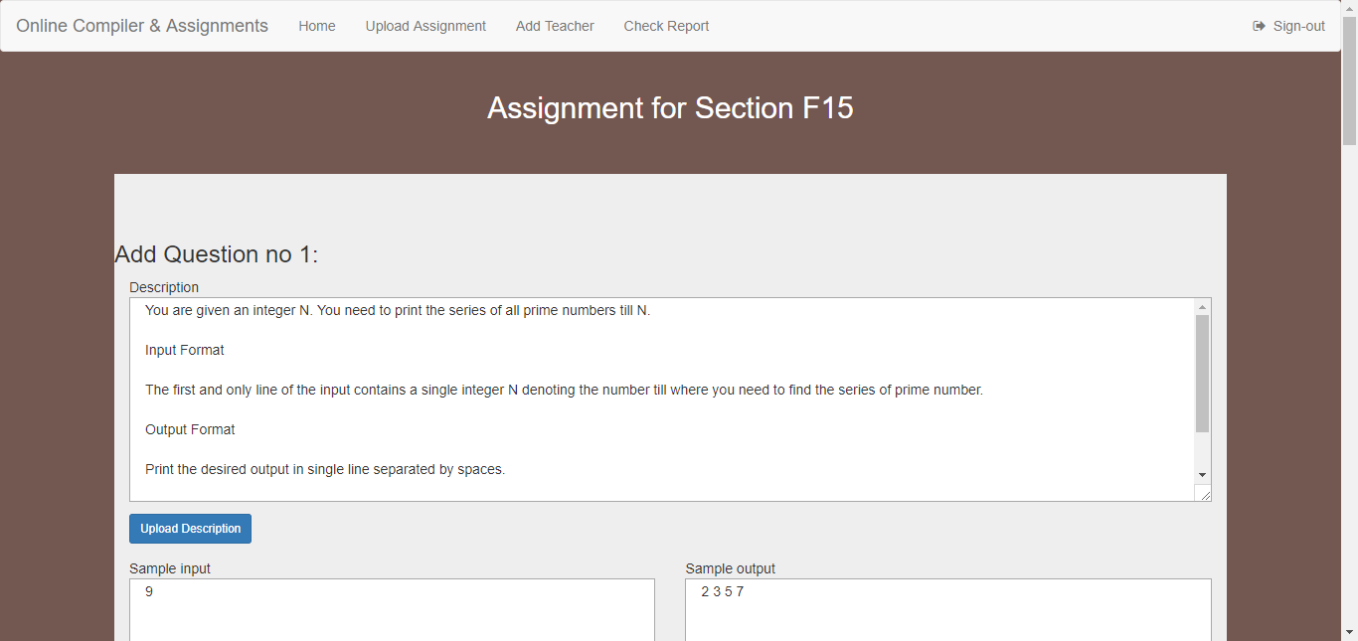
DESCRIPTION ABOUT QUESTION

Slide 12
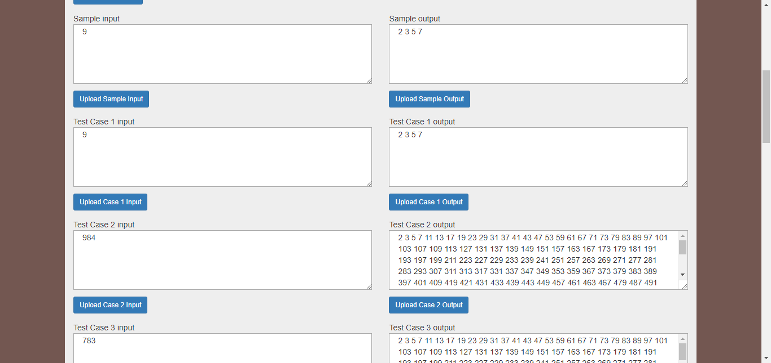
PROVIDING TEST CASES

Slide 13
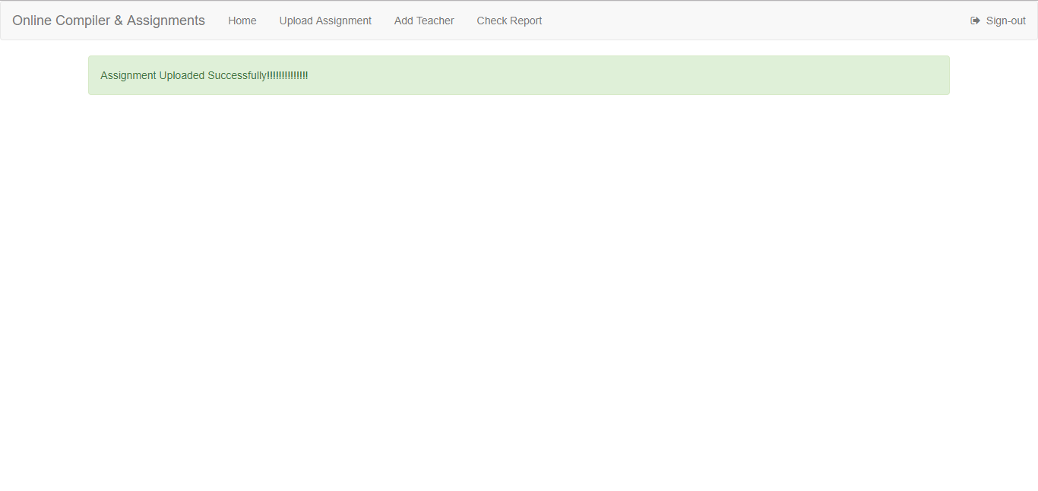
ON SUCCESSFUL UPLOAD OF ASSIGNMENTS

Slide 14
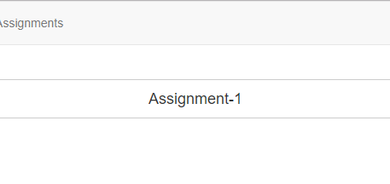
After adding Assignments
After the teacher have added some assignments for a section, the students of that section can access that assignment by going to the Assignments tab.
Assignments tab shows all the assignment that are available for the section to which current user (Student) belongs.

Slide 15
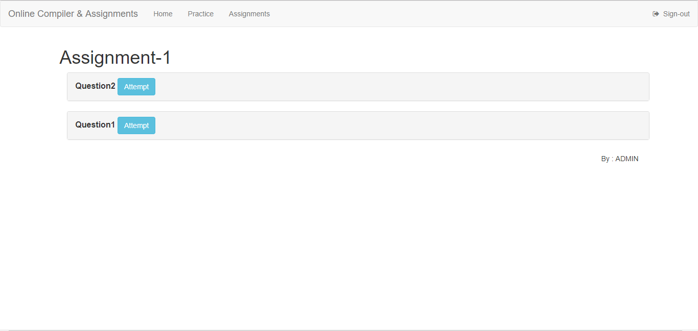
AFTER STUDENT LOGIN, THIS IS HOW ASSIGNEMENTS ARE SHOWN

Slide 16
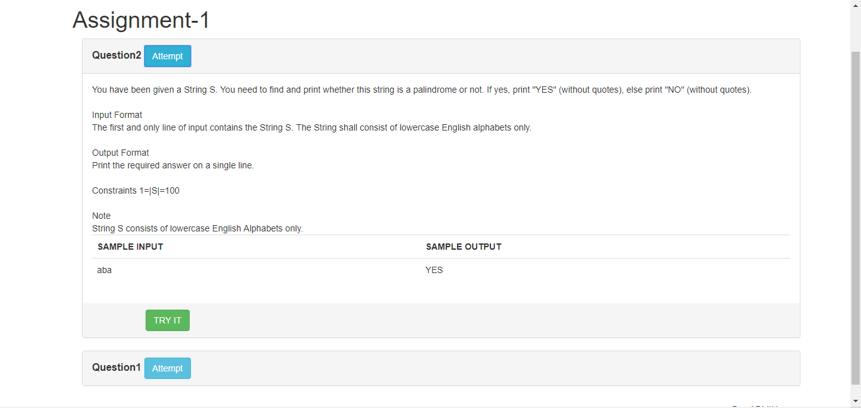
AFTER SELECTING THE ASSIGNMENT…
The student can view all the questions and try to solve them. Clicking on the “TRY IT” button opens a new tab in which the student can solve that attempt to solve that question.

Slide 17
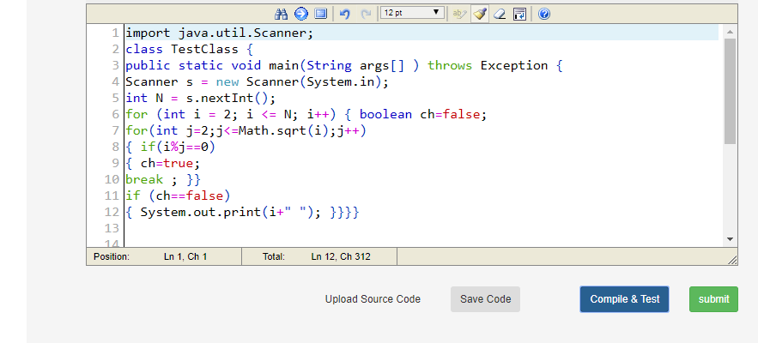
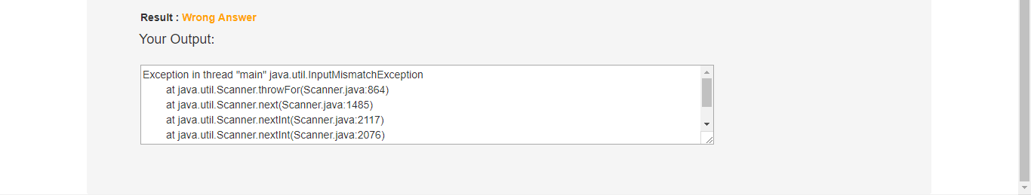
Compile & Test button will check the student solution against the Sample Test Cases and show the result to the student.

Slide 18
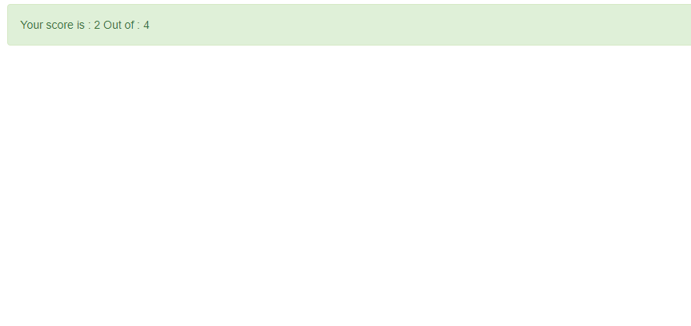
Submit button will check the student’s solution against all the test cases and show the score to the student as well as submit the score in the database so that Teachers can check it as per their convenience.

Slide 19
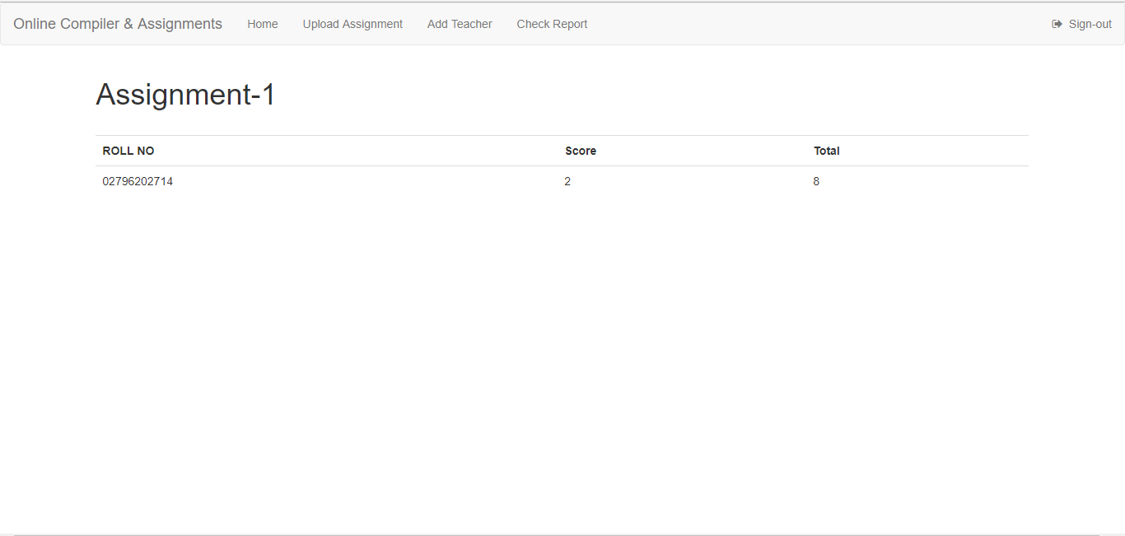
TEACHER CAN CHECK THE REPORT BY LOGGING AGAIN

Slide 20
FUTURE SCOPE
TIME REMIAINING
DYNAMIC GRADING SYSTEM
DAILY CHALLENGES
PRACTICE PROBLEMS
ADDING DIFFERENT LANGUAGES COMPILER (GCC,PYTHON,ETC.)

Slide 21
Thank you
Prepared by
Ayush Sharma (02396202714)
Apoorv Agrawal (02796202714)
Ananya Lal (04496202714)
Deepak Ghariyav (05496202714)

